Slide 1
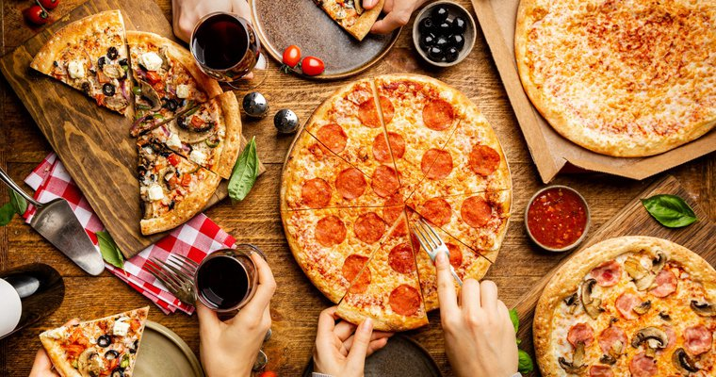
PIZZA SALES ANALYSIS
A project by DEBASMITA PAUL

Slide 2
Contents
Case study
Objectives
Important factors to optimize the business
Data Analysis
Table Analysis
Data Normalization
Main Objectives with associated charts
Major Insights

Slide 3
Case Study
This case study comprises of four datasets:-
The first dataset contains details of individual items ordered in each transaction.
The second dataset records each individual order placed by customers.
The third dataset stores the information about different types of pizzas offered.
The fourth dataset contains detailed information about individual pizza items that can be ordered.

Slide 4
Objectives
The pizza restaurant wants to optimize its operations, improve customer satisfaction, and maximize revenue by gaining a deeper understanding of its sales performance and customer preferences.

Slide 5
Important Factors to optimize the Business
Total number of orders placed
Total revenue generated from pizza sales
Highest-priced pizza
Most common pizza size ordered
Top 5 most ordered pizza types along with their quantities
Total quantity of each pizza category ordered
Distribution of orders by hour of the day
Category-wise distribution of pizzas
Group the orders by date and calculate the average number of pizzas ordered per day
Top 3 most ordered pizza types based on revenue
Percentage contribution of each pizza type to total revenue
Cumulative revenue generated over time
Top 5 most ordered pizza types based on revenue for each pizza category

Slide 6
Data Analysis
For analyzing the data , various factors affecting the business
In this case study, there are four tables order_details(contains details of individual items ordered in each transactions), orders(records each individual order placed by customers), pizza_types(stores the information about different types of pizzas offered, pizzas(contains detailed information about individual pizza items that can be ordered)

Slide 7
Table Analysis
1. Order_details table contains:-
order_details_id: A unique identifier for each entry in the order_details table.
order_id: Refers to the unique ID of the order associated with these details (foreign key referencing the orders table).
pizza_id: The unique identifier of the pizza ordered (foreign key referencing the pizzas table).
quantity: The number of pizzas of the specified type ordered.
2. orders table contains:-
order_id: A unique identifier for each order.
date: The date on which the order was placed.
time: The time at which the order was placed.
3. pizza_types table contains:-
pizza_type_id: A unique identifier for each type of pizza.
name: The name of the pizza type (e.g., Margherita, Pepperoni, etc.).
category: The category or classification of the pizza (e.g., Vegetarian, Non-Vegetarian).
ingredients: The list of ingredients used in this type of pizza.
4. pizzas table contains:-
pizza_id: A unique identifier for each pizza.
pizza_type_id: Refers to the type of pizza (foreign key referencing the pizza_types table).
size: The size of the pizza (e.g., Small, Medium, Large).
price: The price of the pizza depending on its size and type.

Slide 8
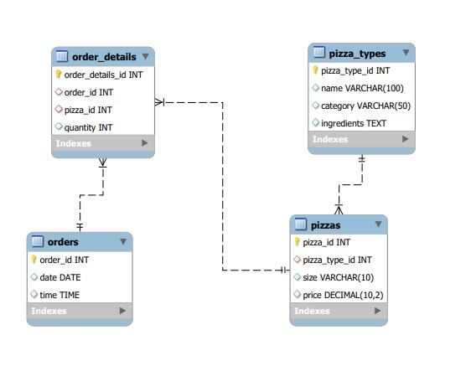
Data Normalization
.
The orders table is linked to the order_details table through the order_id field, which is a foreign key in the order_details table. One order can have multiple order details making this a one-to-many relationship.
The order_details table is linked to the pizzas table through the pizza_id field, which is a foreign key in the order_details table.This is a many-to-one relationship.
The pizzas table is linked to the pizza_types table through the pizza_type_id field, which is a foreign key in the pizzas table. This is also a many-to-one relationship.

Slide 9
Main Objectives with associated charts
Most common pizza size ordered
Large pizzas are the most preferred size, likely due to their ability to serve more people. The low demand for XL and XXL pizzas could suggest that customers find large or medium pizzas sufficient for their needs.

Slide 10
Top 5 most ordered pizza types with quantities
The Classic Deluxe Pizza ranks first with around 2,450 orders, followed by The Barbecue Chicken Pizza with 2,430 orders. The Hawaiian Pizza, The Pepperoni Pizza, and The Thai Chicken Pizza complete the list, with slight variations in their order quantities, all hovering around 2,340 to 2,450.

Slide 11
Total quantity of each pizza category ordered
Classic is the most ordered, with around 15,000 units, while Chicken has the fewest, slightly above 10,000.This highlights that Classic pizza is the top seller, with Chicken being the least popular.

Slide 12
Distribution of orders by hour of the day
The highest order activity occurs around hour 3,with approximately 2500 orders, indicating a significant peak in demand during the early hours.
A dip is observed between hours 4 and 6,suggesting fewer orders during this time, potentially an off-peak period.
Another smaller peak in orders is seen between hours 7 and 9, followed by a gradual decline, reaching almost no orders by hour 14.

Slide 13
Category-wise distribution of pizzas
Supreme and Veggie pizzas have the highest distribution, both reaching a count of 9.
Classic pizza follows closely with a count of 8.
Chicken pizza has the lowest distribution with a count of 6.

Slide 14
Top 3 most ordered pizza types based on revenue
The Thai Chicken Pizza generated the highest revenue, followed by the Barbecue Chicken Pizza, and then the California Chicken Pizza. The length of each bar represents the revenue , with all three pizzas, earning between 40,000 and 43,500 units, making it easy to compare which pizza performed better in sales. The Thai Chicken Pizza clearly stands out as the most profitable.

Slide 15
Percentage contribution of pizza based on revenue
The Classic Pizza contributes the largest share, accounting for 27% of the total revenue. This is followed closely by the Supreme Pizza at 25%. Both types demonstrate strong customer preference and are key drivers of sales.
The Chicken Pizza and Veggie Pizza contribute equally, each making up 24% of the total revenue. Their similar performance highlights their popularity among different customer segments.

Slide 16
Cumulative Revenue Generated Over Time
There is a significant increase in revenue between March and July, indicating a period of rapid growth, potentially due to high demand or successful business strategies.
After July, the growth slows slightly, but revenue continues to rise steadily through December, showing sustained business performance throughout the year .

Slide 17
Top 5 most ordered pizza types based on revenue for each pizza category
The Thai Chicken Pizza, Barbecue Chicken Pizza, And California Chicken Pizza are the top performers , each generating nearly 50,000 in revenue, showing their strong popularity. In contrast, the Southwest Chicken Pizza comes in fourth, with revenue between 35,000 and 40,000, indicating it’s moderately ordered. Finally, the Chicken Alfredo Pizza has the lowest sales, earning around 20,000 in revenue, making it the least popular among the five.

Slide 18
Total number of orders placed is 21350
Total revenue generated from pizza sales is 817860.05
The highest-price pizza is 35.95
The average number of pizzas ordered per day is 138.

Slide 19
Major Insights
The Classic Deluxe Pizza and Barbecue Chicken Pizza were the most ordered, both with over 2400 orders. This indicates strong customer preferences for these flavors, suggesting they could be featured in promotions or meal deals.
The Thai Chicken Pizza led in revenue generation, closely followed by Barbecue Chicken Pizza and California Chicken Pizza. These pizzas are key to driving revenue, so continuing to promote them could boost profitability.
Large pizzas were the most popular, with over 18,500 orders. This suggests customers prefer larger pizzas, likely due to their value in serving more people. Offering combo deals with large pizzas could be effective. With only 544 and 28 orders respectively, extra-large sizes were not as popular. This may suggest a need to either reduce stock of these sizes or phase them out in favor of smaller, more popular sizes.
The highest order activity occurred around Hour 3 (possibly 3 AM) with approximately 2500 orders. This unusual peak could indicate late-night demand, suggesting a potential for extending business hours or focusing on late-night promotions. A dip in orders was observed between Hour 4 and 6, representing an off-peak period. This suggests that fewer staff or reduced operations during these hours may be more cost-effective.
The Supreme and Veggie pizzas had the highest category-wise distribution, with 9 varieties each, followed closely by the Classic category. This shows strong customer interest in diverse vegetarian options. The Chicken category had fewer varieties, which could suggest an opportunity for innovation within this category to attract more customers.
A significant increase in revenue between March and July indicates a period of high demand, possibly due to seasonal promotions or events. Sustained growth afterward suggests effective business strategies.
The Classic Pizza contributed the highest percentage (27%) to total revenue, followed closely by Supreme Pizza (25%). These categories are key drivers of sales and should be prioritized in menu marketing.
Classic and Supreme are consistently popular, making them strong candidates for seasonal deals, new flavors, or special promotions to attract more customers.
Chicken Category Though lower in popularity, Chicken pizzas still contribute significantly to revenue. Further analysis of customer feedback could help improve the offerings in this category.
The restaurant handled 21,350 orders and generated $817,860.05 in total revenue. With an average of 138 pizzas ordered per day, business appears to be consistent, though there's room for optimizing operations to increase daily orders.
The highest-priced pizza at $35.95 indicates the presence of premium options on the menu. These premium pizzas could be marketed more aggressively to increase their sales.
Leveraging the popularity of high-revenue pizzas like the Thai Chicken and Barbecue Chicken pizzas can help increase sales. Additionally, introducing new varieties in underperforming categories could diversify the menu.

Slide 20
THANK YOU

